Slide 1

Free Online Training for Data Professionals.
By the Community, For the Community.

Slide 2
GroupBy Code Of Conduct
The Quick Version
We are dedicated to a harassment-free experience for everyone, regardless of who you are and what makes you you. We recognize the right of any individual to attend and participate. Anyone. This is included but not limited to gender identity and expression, sexual orientation, disability, physical appearance, body size, race, religion, or any other classification, affiliation, or label.
We do not tolerate harassment in any form. For the duration of your engagement with GroupBy and its programs, you are expected to act appropriately and to adhere to this Code of Conduct. This includes conduct in-person and online, at the conference itself, as well as any non-conference programs that may include participants: including talks, workshops, parties, on social media, and other online forums. GroupBy participants violating these rules may be sanctioned or expelled without a refund (if that applies) at the discretion of the conference organizers.
You can review the full policy at: GroupBy.org/Code-of-Conduct

Slide 3

Jared Poche
ChannelAdvisor
Database Engineer
Speaker\Blogger
Sqljared.com
Query optimization is relatively easy when you look at a plan and find table scans, hash match joins, and missing indexes. But how do you find opportunities when all the low hanging fruit has been picked? This session is a case study on improving a procedure that runs 350 million times per day, so any improvement is greatly magnified. We will discuss where we found opportunities to improve a procedure running in 3.1 milliseconds; how effective our attempts were, what didn't work, and the results achieved.
https://twitter.com/SqlJared
https://github.com/sqljared
https://www.linkedin.com/in/jared-poche/

Slide 4
Every Millisecond Counts
A case study in tuning a Frequent procedure to <1ms duration

Slide 5
Jared Poche
10 year veteran of Microsoft CSS
He/him
Database Engineer
ChannelAdvisor
/jared-poche
@sqljared
sqljared@outlook.com
sqljared.com
Blogger, SQL Saturday and Virtual PASS speaker

Slide 6
Expectations
Intermediate/Advanced level
Not standard query tuning
No missing indexes or table scans
Goals
Attention to detail
Learn code techniques
Wholistic view (think outside the DB)

Slide 7
Foundation AND Topics
Upsert procedures
Table variables (no statistics)
Table valued parameters
Memory optimized table variables
Table spool
Indexed Views
Halloween Problem and Protections

Slide 8
Case study
Inventory Management and Updating Quantity
Updating multiple rows by table valued-parameters
Updates are customer driven
3.1ms average duration
Query Store providing all times
285 million – 350 million executions per day

Slide 9
Procedure outline
Populates a few variables
Checks for item listings
Aggregates listings
Performs an update
Majority of the duration (80%)
Inserts missing rows
Triggers another table

Slide 10
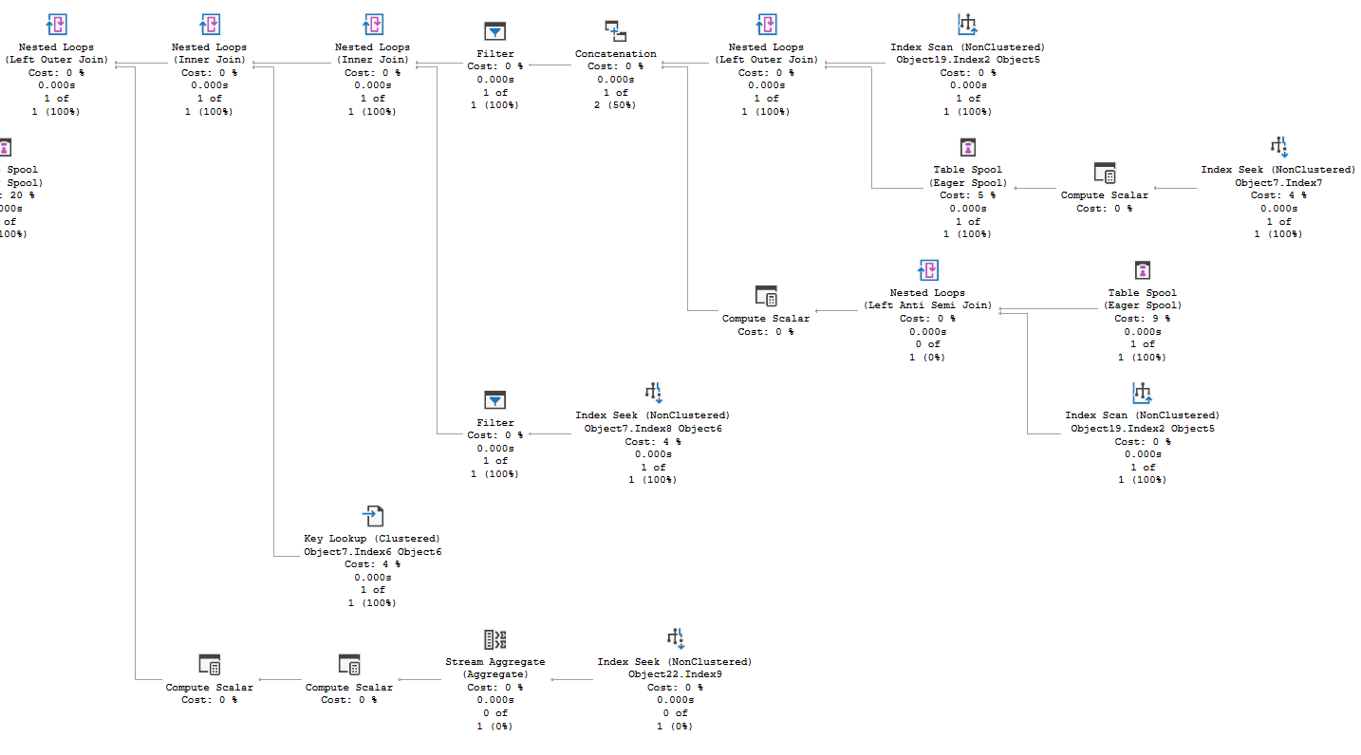
Update Plan: Where’s the issue?

Slide 11
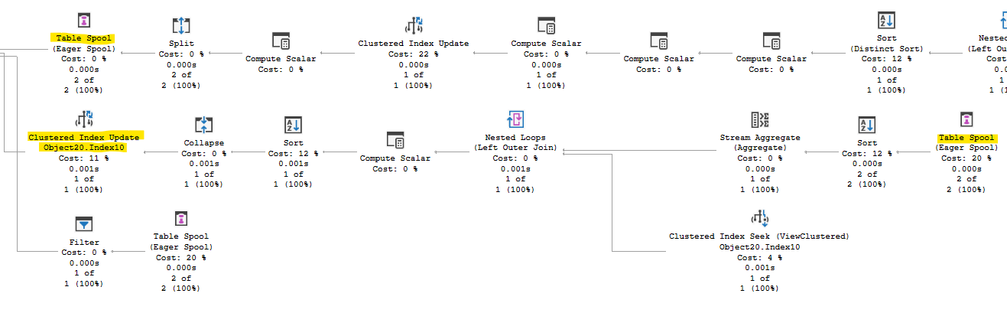
Table Spool?

Slide 12

Ideas
Table Spool\View Updates
Unnecessary INSERTs
Trigger reduction
Table Variables and Cardinality
UPDATE
Key Lookups
Multiple references

Slide 13
Indexed View
Requires a table spool
Updates the view as part of the UPDATE
DML operators much more expensive than a seek
This view is for aggregation
1 row vs 2-5 rows
Reduced duration by 17-25% for the procedure
Expensive, as estimated
Removed the index

Slide 14

Memory Optimized Table Variables
Lack of statistics can lead to bad plans
SQL Server optimizer assumes 1 row
Temp tables have stats
TEMPDB contention
May work in other cases, not will 100s of millions of executions per day!
Memory Optimized: hard to beat
Want specific behavior? Give SQL a hint.

Slide 15
Unnecessary Inserts
In case row doesn’t exist for UPDATE
We will UPDATE many times, INSERT once
INSERT 0 rows, still run the TRIGGER
If we UPDATE x rows, matching TVP
Skip the INSERT statement entirely
350 million executions to 6 million
1.95ms → 1.91ms
14,000 seconds per day
Also reduced trigger executions

Slide 16
Update Exec Plan

Slide 17
Update Statement
Two statements; 1 runs per exec
Redundant aggregate in CTE
Second reference to base table in CTE
Unified CASE logic
Key Lookup
Same two key columns as clustered
Hint to use the clustered PK
~28% duration reduction
0.54ms * 350M = 189,000 sec/day

Slide 18
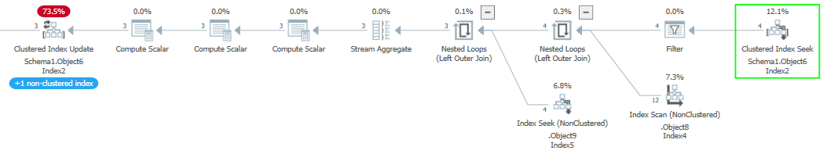
Optimized Update Plan

Slide 19



Mission Accomplished?
Reduced the procedure’s duration from 3.1ms to 1.4ms
Bonus idea: unnecessary UPDATEs
Automated quantity updates repeat values
Limit updates to when quantity really changes
WHERE old.Quantity <> new.Quantity

Slide 20

Halloween Problem
Can affect any DML statement
Don’t try to change the thing you are querying
Prime example
SQL Server optimizer prevents the problem
Changes the plan typically to insert a blocking operator
Bad for performance

Slide 21
Bonus solution
Split the operation
Query the data we need into a temp table memory optimized table variable
Do all the math; get new and old quantity
Check results
If the quantity doesn’t change, skip the UPDATE
Changed INSERT logic
Based on LEFT JOIN instead of @@ROWCOUNT

Slide 22

Too much overhead?
Populating the motv: 90-100 µs
Checking results: 10-20 µs
Skipped > 96% of UPDATES
Final duration: 320 µs

Slide 23
Break even
2.00x +0.070 <= 2.00
2.00x <= 1.93
x <= 0.965
x <= 96.5%
What percentage of the time would we need to skip executing the UPDATE statement in my example to break even with the table variable’s overhead?
The update takes 2ms.
The memory optimized queries take 70µs.
Only 3.5%.

Slide 24
References
Thanks to Deborah Melkin (@dgmelkin)
Paul White: the Halloween Problem
Aaron Bertrand: Upsert coding patterns
My blogs on Halloween, blocking operators, and this topic
TVPs and memory optimized table variables
Github links:
QDS Toolbox
Presentation slides and examples

Slide 25
@sqljared sqljared.com

